Slide 1
Deep Learning Based Approach For Detecting Suicidal Ideation in Code-Mixed Hindi-English: Baseline and Corpus
1
19101296 Sadid Islam
ST: Md. Farhadul Islam
RA: Md Humaion Kabir Mehedi
Group-15
Section-01

Slide 2
Introduction
2
bilingual and multilingual speakers tend to use code-mixed text on social media making the detection of suicidal ideation on code-mixed data crucial
suicidal ideation in code-mixed Hinglish
They proposed the use of various existing models to create a baseline for future work in the field

Slide 3
Methodology
3
Dataset Creation and Analysis.
Creation of Hindi-English Bi-lingual Word Embeddings
Deep Learning Models
Experimental Settings / Modeling

Slide 4
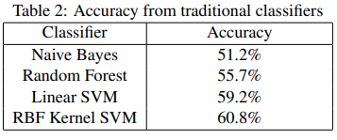
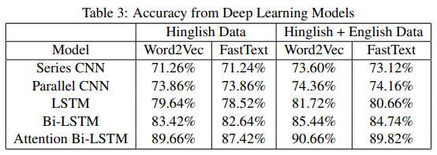

Results
4

Slide 5
Conclusion & Future Work
5
Comparing vectors aligned with multilingual word embeddings generated using MUSE to FastText pre-aligned word embeddings may generate better results
Working on factors such as sarcasm, humor and irony that affect the classification of suicidal ideation explicitly, along with their inclusion in the creation of the model could be another potential avenue for future research

Slide 6
References
6
Deep Learning Based Approach For Detecting Suicidal Ideation in Hindi-English Code-Mixed Text: Baseline and Corpus (aclanthology.org)

